Slide 1



.
.
FACE PuLSe
To provide a seamless, real-time, and secure attendance system using face recognition

Slide 2

SMART INDIA HACKATHON 2025 TITLE PAGE
Problem Statement ID - 25016
Problem Statement Title - Automated Student Attendance Monitoring and Analytics System for Colleges
Theme - Smart Education
PS Category - Software
Team ID - SIH2025_ABHKS415
Team Name (Registered on portal) - AttendFace

Slide 3

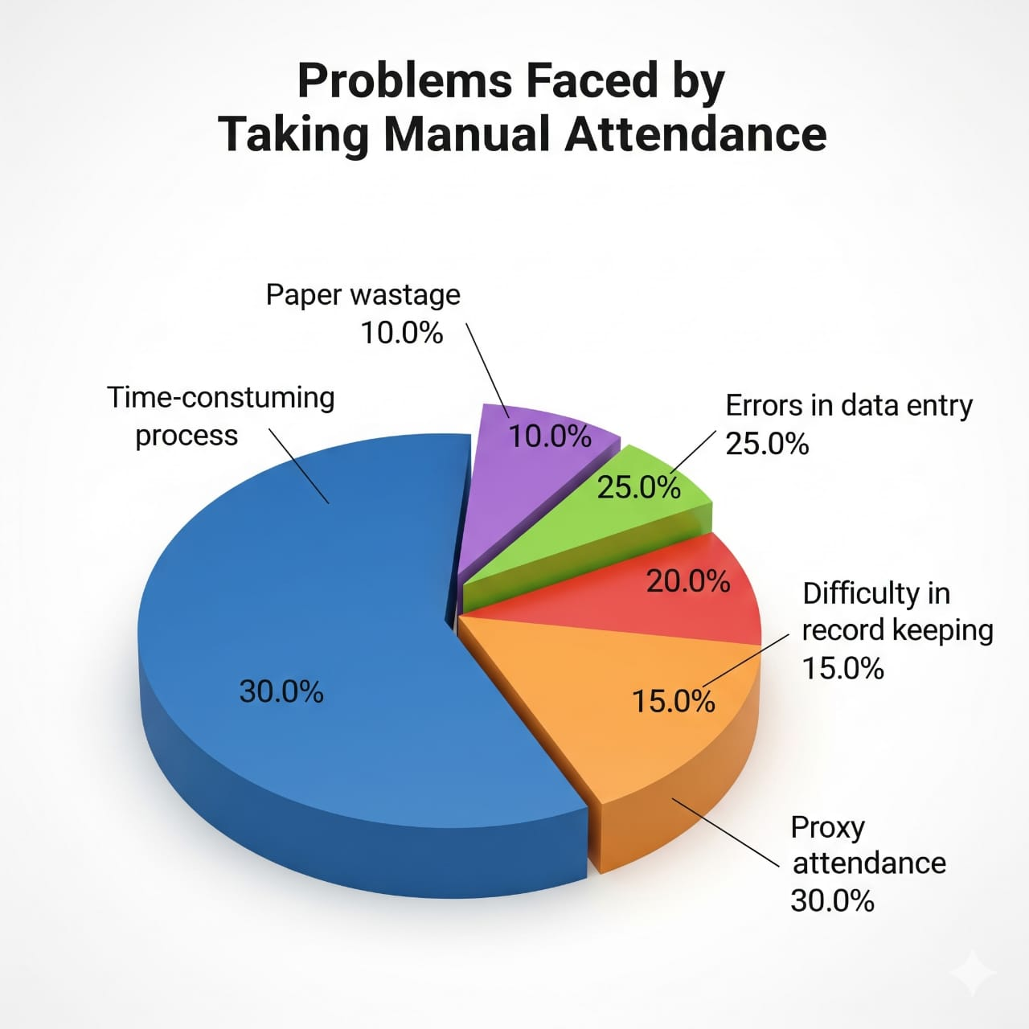
Problems
KEY PROBLEMS
Time Consumption & Inefficiency
Proxy Attendance & Fraud
Human Error & Inaccuracy
Lack of Real-time Data
Hygiene Concerns (Especially Post-Pandemic)
Resource Wastage

Slide 4

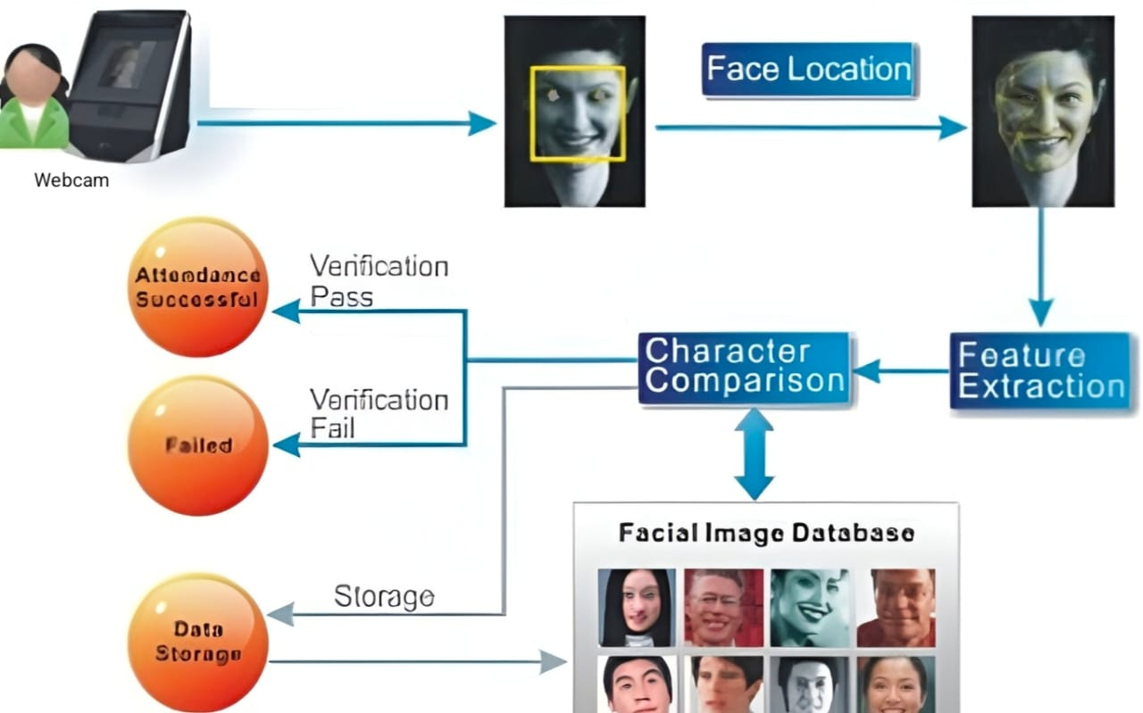
.
Our Solutions
Solutions
Attendance is marked instantly within two seconds.
Data is stored digitally with encryption.
Real-time dashboards for admins and students.
We can integrate with ERP, HR, and Payroll systems.
Our SIH project addresses these challenges head – on by providing a smart, automated, & secure face recognition solution for attendance management.
Over-coming the Problem

Slide 5
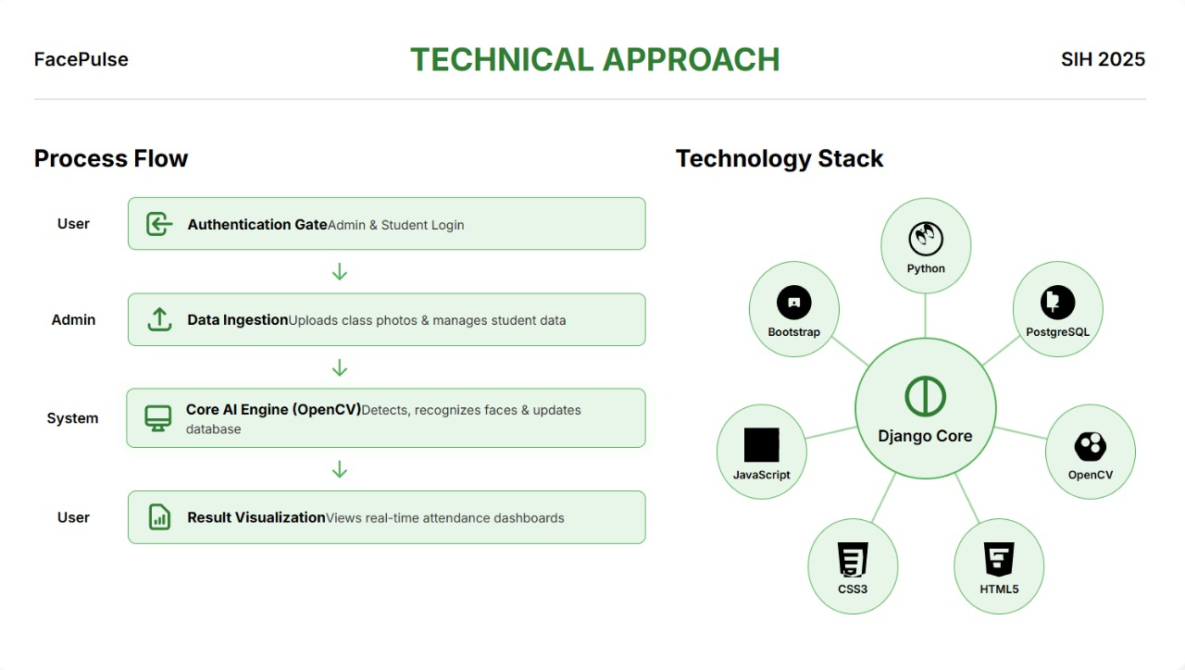
Technical Approach

Slide 6
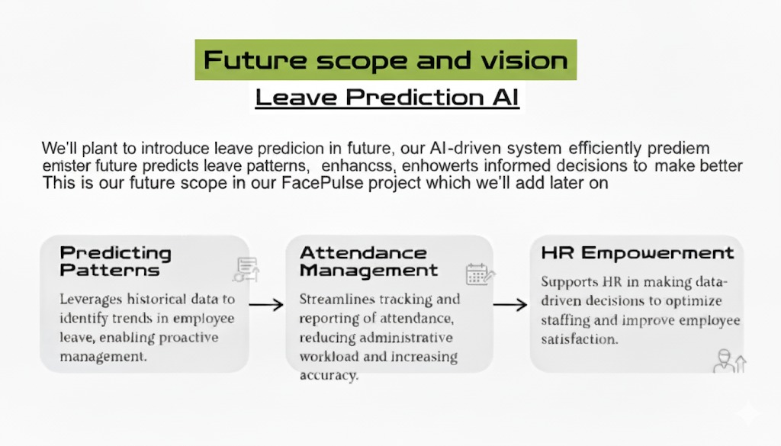

Slide 7
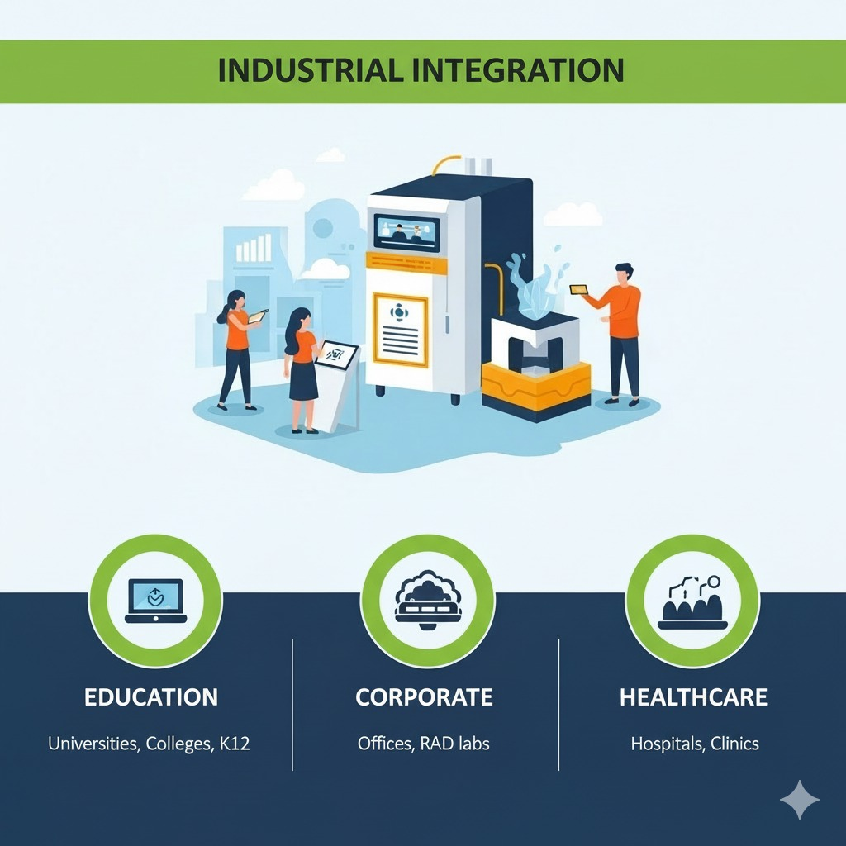

FACEPULSE
FUTURE SCOPE & VISION

Slide 8
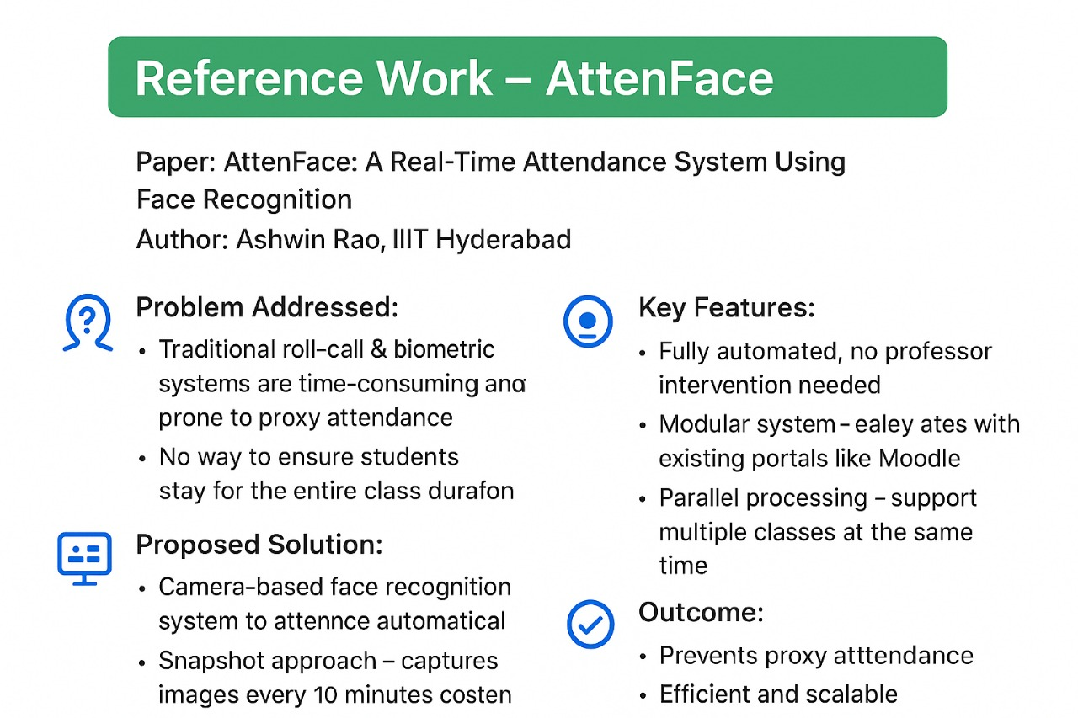
Reference Work – AttenFace

Slide 9


FACEPULSE

